Slide 1
Snake game

Slide 2
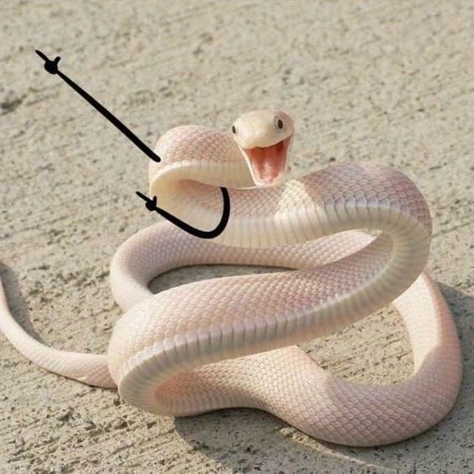
OOP Game Report
GROUP 28
Members
Lê Quốc Phong – ITITIU19181
Trần Nguyễn Thương Trường – ITITIU19228

Slide 3
01
Introduction
Snake is 2D game. We written by JSwing framework of Java.
02
Play & rules
Suitable for everyone, easy to play
03
Score & level
Reflect achievements
04
Diagram
Simply, fully demonstrates of 2D nature

Slide 4
01
INTRODUCTION
From Wikipedia:
Snake is a video game that came out in the late 1970s and has maintained popularity since then, becoming somewhat of a classic. The player controls a long, thin creature, resembling a snake, which roams around on a bordered plane, picking up food (or some other item), trying to avoid hitting its own tail or the "walls" that surround the playing area. Each time the snake eats a piece of food, its tail grows longer, making the game increasingly difficult. The user controls the direction of the snake's head (up, down, left, or right), and the snake's body follows. The player cannot stop the snake from moving while the game is in progress.

Slide 5
02
PLAY
&
RULES

Slide 6
Rules of Snake
1
2
3
Eating food makes the snake grow. When the food is eaten it moves to another random position.
The snake will wrap around to the other side of the screen when it goes off the edge.
The game is over when the snake crashes into itself.

Slide 7
HOW TO PLAY
Up Arrow key
Move up
Left Arrow key
Right Arrow key
Move left
Move right
Down Arrow key
Move down

Slide 8
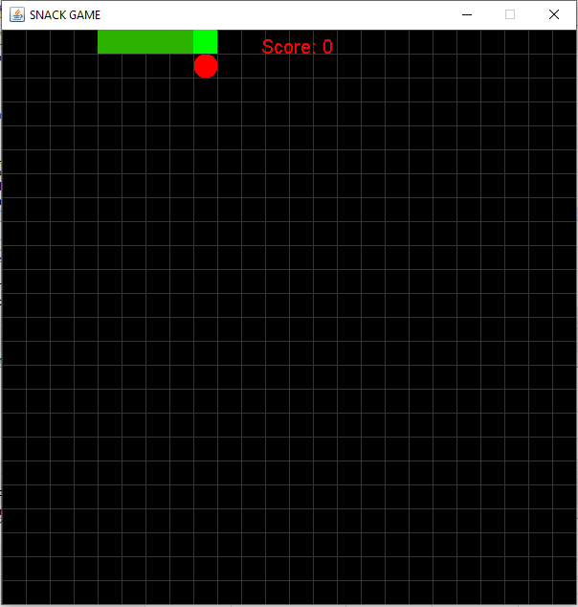
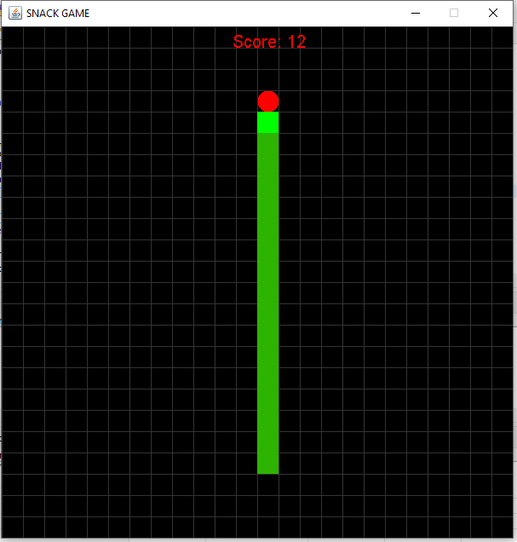
OUR TEAM DEMO

Slide 9
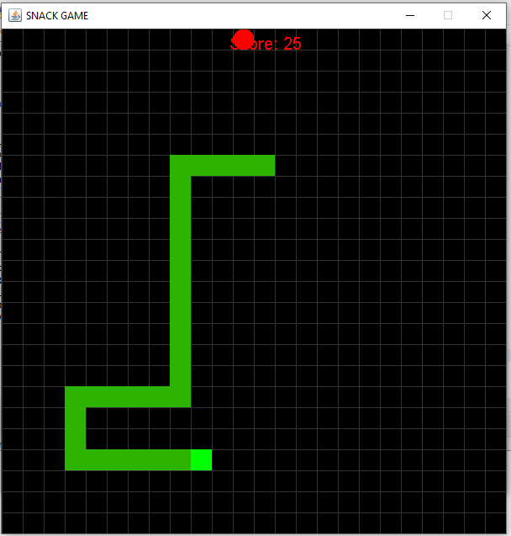
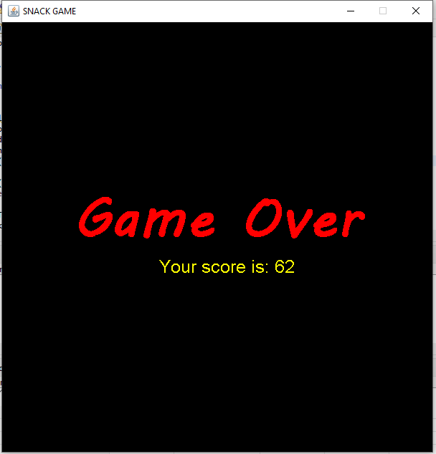

Slide 10
03
Score & Level

Slide 11
Score
The player's score should be based on the number of apples eaten (or equivalently, the length of the snake). The exact scoring algorithm is up to you; most games award more points for each apple as the snake gets longer.
Keep the ten highest scores, along with the names of the players who made those scores. The scores should be kept across all runs of the game. That is, they should not be lost when the program ends.
Keeping (and displaying) high scores isn't as "glamorous" as writing the game itself, but it is harder than you might expect (and more generally useful).

Slide 12
04
Diagram

Slide 13
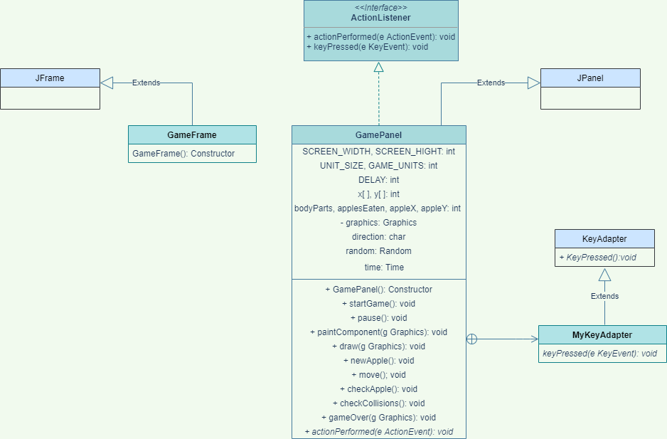

Slide 14
THANK YOU

